Slide 1
Middlesex County’s Work to End Homelessness
Best Practices
State Museum: February 22, 2017

Slide 2

PRINCIPLES
There are no rules
There are only resources

Slide 3

Setting the Stage
No long term study; no isolation of variables, no statement of absolutes, excepts facts, of course. ……..remember those?
Five Year Process

Slide 4

Perfect Storm
Plan to End Homelessness: 2009-2010
Homeless Trust Fund Created: eff. 2010
Freeholders’ Housing First Capital Fund, $1M annually
Formation of Coming Home of Middlesex County, Inc. (contracts with County, 2012)
CoC members antsy (eager for a new challenge) 2012

Slide 5

NUCLEAR FAMILY
Middlesex County Government | Middlesex County Continuum of Care | Coming Home of Middlesex County, Inc.

Slide 6
THE COUNTY
Commitment
Financial: Homeless Trust Fund; Housing First Capital Fund; Support Grants; Housing Assistance for Veterans; Allocator of flow-through State Funds (e.g. SSH, ESG); Coming Home
Community Services Dept: Develops and coordinates programs and services to meet basic human needs and improve the quality of life for residents across the lifespan (disabilities, mental health, addictions, aging, veterans, etc.)

Slide 7

Continuum of Care
Coordinated response to addressing homelessness (HUD 1995)
Reaffirmed structure and policies
Expansion of membership
Desire to use data operationally and for planning, in addition to reporting
Critical look at the HUD $$ application review process

Slide 8

HUD Application Review Process
Active, not reactive
  no automatically renewed approvals;
  Performance Measures
  Data Driven
  Increased PSH
Reallocated, not new
Not desperate: we can always create what we see we need

Slide 9

Middlesex County Leasing Dollars
RESOURCE from HUD, owned and managed by County head of CoC
  Assistance on a rolling basis
  Tenant-based
  Tri-party lease
34 additional HH

Slide 10

Coming Home’s Mission
Coordinate the implementation and evolution of the County’s Plan to End Homelessness by employing collaborative strategies, fostering public-private partnerships and providing the leadership necessary to ensure the efficient development of solutions to end homelessness in our County.
Contracts with the County

Slide 11
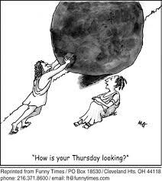
Shorthand: Building a System horrible elevator speech changing a culture

Slide 12
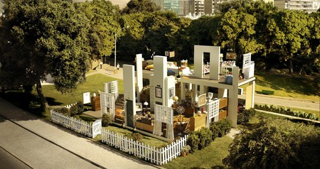
Agencies Without Walls

Slide 13
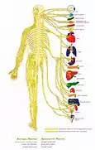
Parts, Processes and Outcomes
PARTS
Data
Stakeholders
PROCESS
HMIS
MC Coalesced initially around building and administering HMIS

Slide 14

BROADEN OUTREACH develop more processes
MUNICIPALITIES
  Leadership
  Police Depts.
  Librarians
  Schools
  PHAs
FUNDERS
AFFORDABLE HOUSING PROVIDERS

Slide 15

Homes for Homeless
Program
Coordinated, needs-based process for the creation of supportive, permanent housing
Collaborative Development
  3 months’ reconnaissance
  Include all municipal leadership, funders, affordable housing developers and social service providers
Push and Pull Project Models
Again, opportunity for collaboration

Slide 16

Coordinated Assessment Initiative
Single point of entry for anyone homeless or at risk of homelessness
Year-long collaborative development
Uniform assessment of persons’ needs
Prioritization of referrals to available
and appropriate resources, based
on length of homelessness and severity of needs

Slide 17
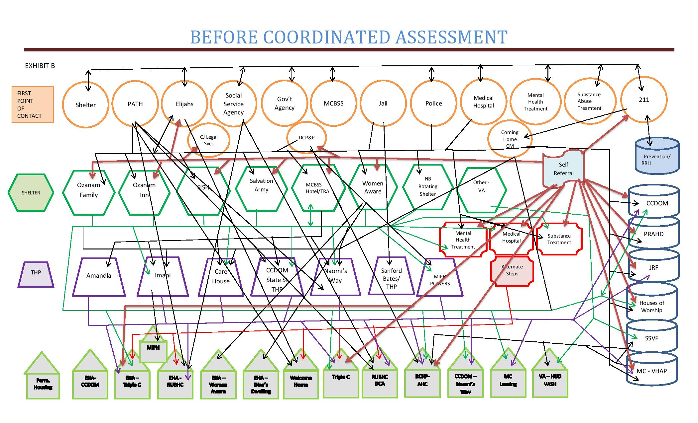
Uncoordinated Assessment

Slide 18
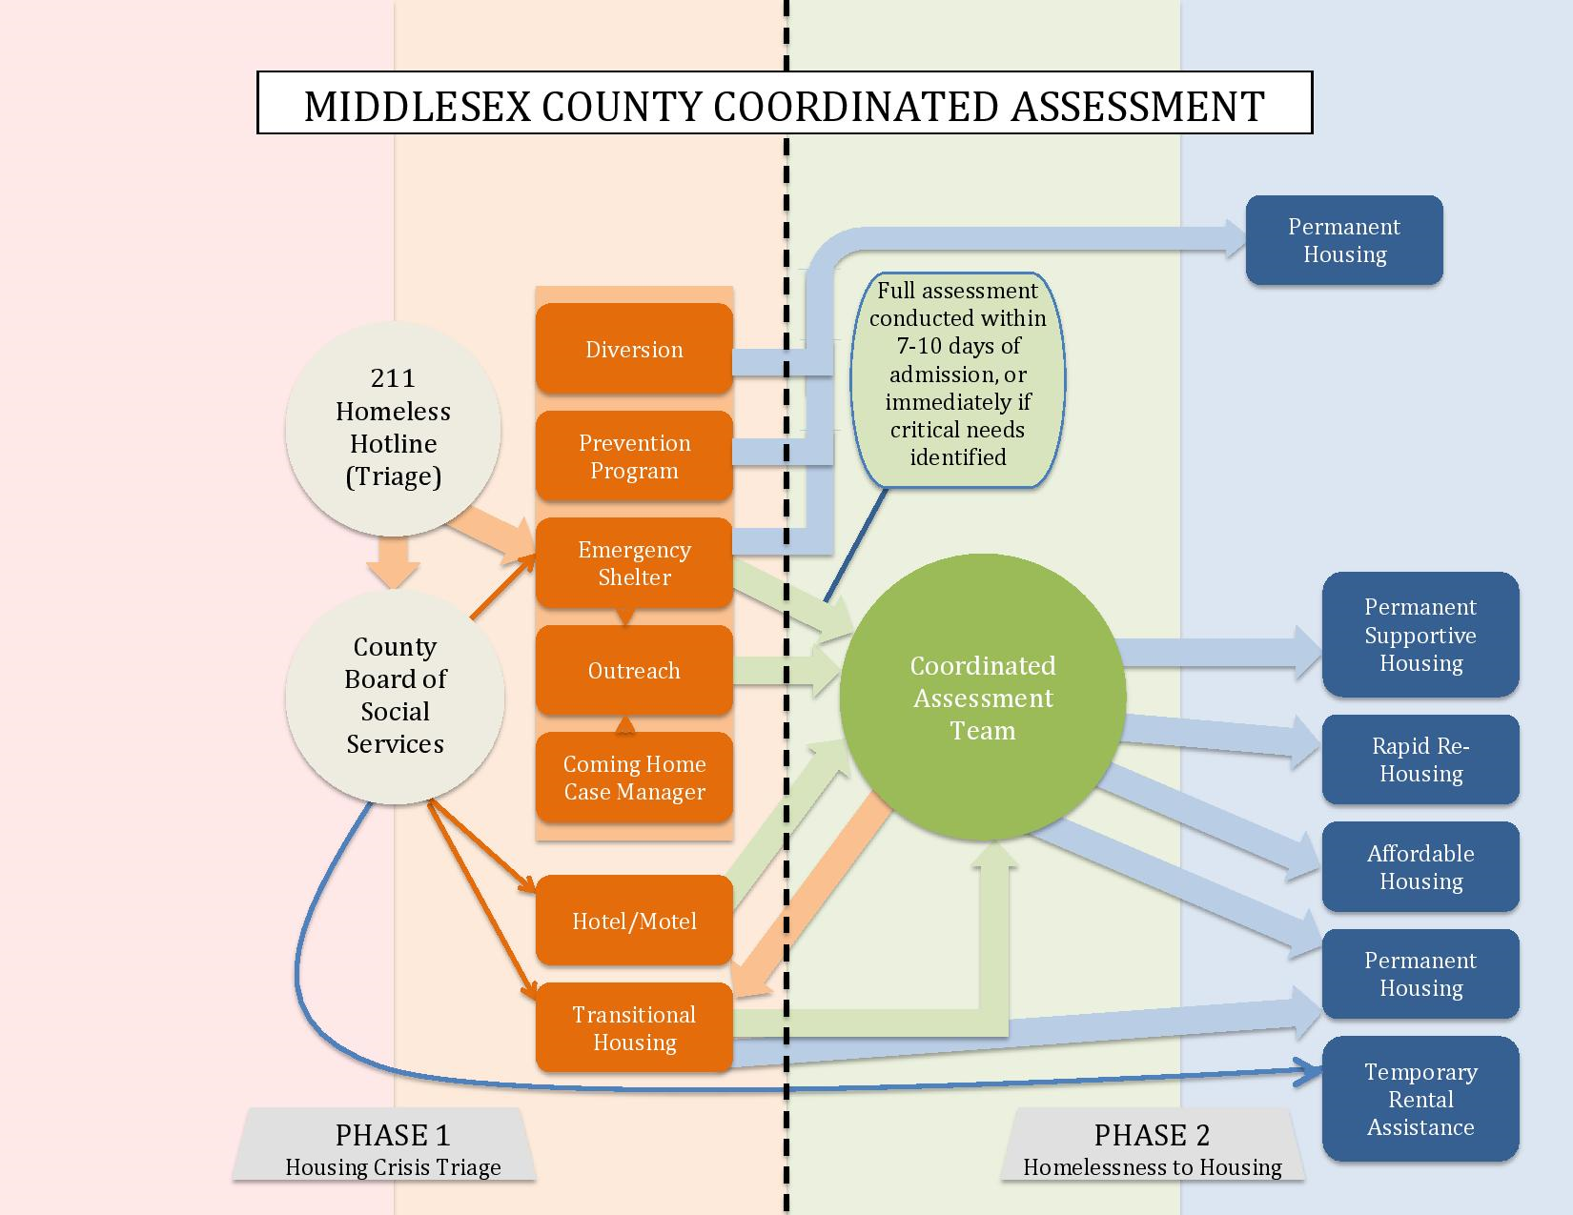

Slide 19
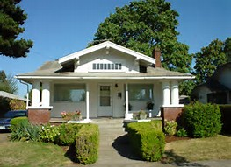
Impact of Coordinated Assessment
Permanently housed 25 households with existing resources
33 State Rental Assistance (SRAP) Vouchers from DCA
  11 housed
  10 perfected vouchers in hand (8 sent to State for validation)
Total: 46 HH permanently housed with CA

Slide 20

System Outcomes
Function Zero for Vets HLSNS
24% reduction in HLSNS year/year past 2 years
Inventory in Units:
  246 PSH (inc. 57 new in 2017);
  other PH: 40 (Kil. and TC)
  RR + CHCM: @75+ 115 = 190
  TOTAL: 476 HH
Creation of system

Slide 21
Extended Family : Working Together to Solve Homelessness in Middlesex County
Corrections
HUD
State
Affordable Housing
Developers
PHAs
Police
MC Govern-ment | MC Continuum Of Care | Coming Home
Community Providers
Librarians
Faith-based Orgs.
Munici-
palities
Schools
Healthcare System

